Slide 1
ASP.NET Introduction
Mirela Gutica Comp 4952
Technical Programming
Computer Science Technology
BCIT

Slide 2
Web Development Technologies
Client-side technologies
HTML, DHTML, XHTML, HTML5, JavaScript
Server-side technologies
ASP (Active Server Pages)
JSP (Java Server Pages)
PHP (Hypertext Preprocessor)
ASP.NET is the next generation of ASP
Migration from ASP to ASP.NET is not easy
ASP and ASP.NET can work side by side

Slide 3
What is ASP?
Server-side Web programming technology popular in late 90’s and early 2000
Consists of static HTML interleaved with Java Script
ASP intrinsic objects (Request, Response, Server, Application, Session) provide services
Commonly uses ActiveX Data Objects (ADO) to interact with databases
ADO: set of Component Object Model (COM) objects for accessing data sources
Application and session variables
Application and session begin/end events
ASP manages threads and database connections

Slide 4
ASP Page
HTTP request
(form data, HTTP header data)
HTTP response HTML, XML
ASP page
(static HTML, server-side logic)

Slide 5
History: ASP Successes and Challenges
Simple procedural programming model
Access to COM components: ActiveX Data Objects (ADO), File System Object, Custom components
Script-based: no compiling, just edit, save & run
VBScript, JScript – leverages existing skills
Support for multiple scripting languages
Coding overhead (too much code)
Poor code readability (too complex; code and UI intermingled)
Maintaining page state requires more code
Difficult reuse
Supporting many types of browsers is difficult
Limitations of session state
Limited support for caching, tracing, debugging, etc.
Performance and safety limitations of script

Slide 6
What is ASP.NET?
Server-side Web programming technology
Core assemblies installed from the .NET Framework version 2.0 are still used by ASP.NET 3.0 and 3.5.
ASP.NET 3.5 adds new types and features and capabilities to the framework
ASP.NET 4.0
new features are added and productivity is improved
Latest version: ASP.NET 4.5.1
new ASP.NET membership system, a new scaffolding system, support for custom web servers, new project templates and performance enhancements

Slide 7
ASP.NET Key Features
ASP.NET is built upon .NET Framework and Internet Information Server (IIS)
Simple programming model
Multi-browser support
XML configuration
Compiled code
Event-driven programming
Higher scalability
Session management
Caching
Debugging
Extensibility
Separation of code and UI
Security
ASPX, ASP side by side
Simplified form validation
Cookieless sessions

Slide 8
Web Forms and Web Services
Web Forms
Programmable Web Pages
Drag and drop development convenience
Server side controls
Event model
Support for C#, VB.NET, JScript.NET
Web Services
Allow the developer to expose the functionality of the application via HTTP and XML
The client who knows the protocol can call the service
Use the functionality exposed by the application without being tied into the application’s GUI

Slide 9
ASP.NET HelloWorld.aspx
<%@ Page Title="Home Page" Language="C#" MasterPageFile="~/Site.master" AutoEventWireup="true"
CodeBehind="Default.aspx.cs" Inherits="TestWebApplication._Default" %>
<h1>
Welcome to ASP.NET!&nbsp;&nbsp;&nbsp;&nbsp;
<asp:Button ID="Button" runat="server" Text="Button" Height="29px"
onclick="Button1_Click" Width="69px" />
&nbsp;&nbsp;&nbsp;
</h1>
<h2>
<asp:Label ID="Label" runat="server" Text="Label"></asp:Label>
</h2>
<h2>
&nbsp;</h2>
<p>
To learn more about ASP.NET visit <a href="http://www.asp.net" title="ASP.NET Website">www.asp.net</a>.
</p>
</asp:Content>

Slide 10
ASP.NET Programming Architecture and Object Model
ASP.NET parses and compiles a page into a object that extends Page.
This object processes incoming requests to the web server.
Web controls render HTML text to the stream
User code executes on the web server using page or control event handlers
Web Controls are objects
Derived from System.Web.UI.Control
The web page is an object too
Derived from System.Web.UI.Page
A page can have methods, properties, etc.

Slide 11
Postbacks
Technique for handling form data in Web Forms
Page-level property
A postback occurs when the user submits the form to process the input and the page reloads.
In ASP and other server-side technologies the state of the page is lost upon postback, unless you explicitly write code to maintain state
By default, ASP.NET maintains the state of all server-side controls during a postback.
Server-side control objects are automatically populated during postback
Works with all browsers
Use in Page_Load
Boolean = Page.IsPostBack
Returns false if the page was loaded for the first time
Returns true if the page is loaded as a result of a client reload
Are refresh and postback the same thing?

Slide 12
Server-side Controls
Multiple sources of controls
Built-in
3rd party
User-defined
Controls range in complexity and power: button, text, drop down, calendar, data grid, ad rotator, validation
Can be populated via data binding
Controls can provide automatic browser compatibility
Can target UpLevel or DownLevel browsers (UpLevel browsers are the newer browsers, DownLevel browsers support HTML 3.2)
http://msdn.microsoft.com/en-us/library/x3k2ssx2(v=vs.100).aspx

Slide 13
Development: Code-Behind
Two styles of creating ASP.NET pages
Controls and code in .aspx file
Controls in .aspx file, code in code-behind page
Code-behind pages allow developers to separate interface design from code
Allows programmers and designers to work independently

Slide 14
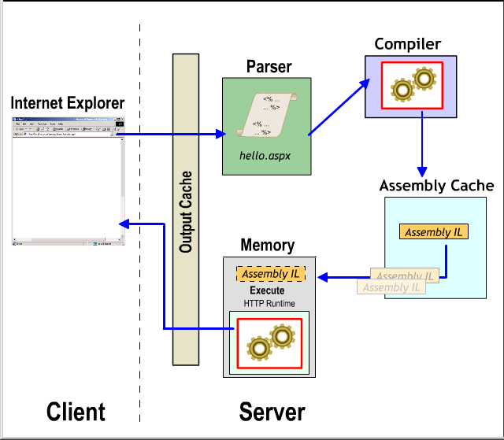
Execution

Slide 15
Page Syntax
The most basic page is just static text
Any HTML page can be renamed .aspx
Directives:
<%@ Page Language=“C#” %>
http://msdn.microsoft.com/en-us/library/vstudio/ydy4x04a(v=vs.100).aspx
Server controls (declared as HTML tags with runat=“server” attribute):
<asp:Button runat=“server”>
Code declaration blocks:
<script runat=“server”>
…</script>
Data bind expressions: <%# %>
<%#DataBinder.Eval(Container.DataItem, "LastName")
Server side comments:
<%-- --%>
Render code: <%= %> and <% %> <% for (int i=0; i < 8; i++) { %> <FONT size="<%=i%>"> Hello World! </FONT>

Slide 16
Page Syntax (2)
Render code: <%= %> and <% %>
<% for (int i=0; i < 8; i++) { %> <FONT size="<%=i%>"> Hello World! </FONT>
Render code is used to write inline expressions within HTML elements
In the case of Web requests, the actual rendering is performed by a client's Web browser or other viewing device
Very important in ASP, used mainly for the backward compatibility in ASP.NET

Slide 17
Server Control Properties
Tag attributes map to control properties
id attributes provide programmatic identifier
<asp:button id=“buttonText" Text="Foo" runat=“server”>
<asp:ListBox id=“listStudents" Rows="5" runat=“server”>
Tags and attributes are case-insensitive
Control properties can be set programmatically
buttonText.Text = “Foo”;
listStudents.Rows = 5;

Slide 18
Maintaining State
By default controls maintain their state across multiple postback requests
Implemented using a hidden HTML field: __VIEWSTATE
Works for controls with input data (e.g. TextBox, CheckBox), non-input controls (e.g. Label, GridView), and hybrids (e.g. DropDownList, ListBox)
Can be disabled per control or entire page
Set EnableViewState=“false”
Lets you minimize size of __VIEWSTATE

Slide 19
Page Life Cycle Events
Methods | Description
Page_Init | Page Initialization
LoadViewState | View State Loading
LoadPostData | Postback Data Processing
Page_Load | Page Loading
RaisePostDataChangedEvent | PostBack Change Notification
RaisePostBackEvent | PostBack Event Handling
Page_PreRender | Page Pre Rendering Phase
SaveViewState | View State Saving
Page_Render | Page Rendering
Page_Unload | Page Unloading

Slide 20
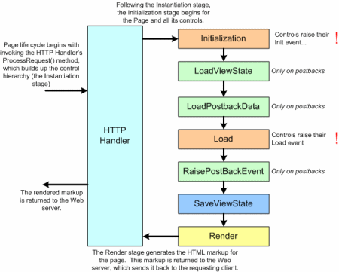
Page Life Cycle Events (2)

Slide 21
Page_Init()
First even to occur when a page is executed
Controls in the .aspx file are initialized
Is fired once the control tree has been created
Controls within the .aspx file have no attributes or properties
It is not good to access them at this stage because might be not created yet
If Postback occurs, this event is not fired again

Slide 22
Load View State
The load view state stage only happens when the page has been posted back
During this stage, the view state data that had been saved from the previous page visit is loaded and recursively populated into the control hierarchy of the Page
During this stage the view state is validated
The ViewState contains stored information that is set by the page and controls of the page
This is carried to and from every aspx page request per visitor
The view state can become invalid due to a number of reasons:
view state tampering or injecting dynamic controls into the middle of the control hierarchy

Slide 23
Page_Load ()
Page_Load fires at beginning of a request after controls are initialized
Good for initializing values
Page_Load fires on every postback
Use Page.IsPostBack to execute conditional logic
A Page/Control is maintaining its state between postbacks; then it needs to be initialized when IsPostBack is false
protected void Page_Load(Object s, EventArgs e) {
if (! Page.IsPostBack) {
// Executes only on initial page load
Message.Text = "initial value";
}
// Rest of procedure executes on every request
}

Slide 24
Page_Load() (2)
Page_Load happens after ViewState and PostData is sent into all server side controls
Server controls in the tree are created and initialized, the state is restored, and form controls reflect client-side data
On Page_Load, controls are not yet rendered, and therefore cannot be referenced
Perform actions common to all requests, such as setting up a database query

Slide 25
Page_PreRender()
Events happening after PageLoad() and before rendering
PreRender() happens just before the page’s HTML is actually rendered
Perform any updates before the output is rendered
Any changes made to the state of the control in the prerender phase can be saved, while changes made in the rendering phase are lost
PreRenderComplete() At this point, all controls are created and the page is ready to render
SaveStateComplete() Occurs after view state and control state have been saved. Any changes you make here won't be persisted to view state

Slide 26
Save View State
The Page class constructs the page's view state, which represents the state that must persist across postbacks
The page accomplishes this by recursively calling the SaveViewState() method of the controls in its control hierarchy
This combined, saved state is then serialized into a base-64 encoded string
In the next stage, when the page's Web Form is rendered, the view state is persisted in the page as a hidden form field

Slide 27
ViewState
Viewstate: ASP.NET pages can store Page state information between the stateless HTTP request and response
The ViewState is the technique used by an ASP.NET Web page to persist changes to the state of a Web Form across postbacks
Applicable to only one page, so every page maintains its own view state
Enabled by default for all ASP.NET pages

Slide 28
Storing Variables in the ViewState
Control and page classes (Page class is derived from System.Web.UI.Control )have a ViewState property
Syntax:
ViewState[keyName] = value
Storing view state and data with each HTTP request and response performs well in general and is important in large Web farm scenarios because it does not matter which Web server services the request: the page state is available in the current context for the server to accurately render the page

Slide 29
Storing Variables in the ViewState (2)
ViewState is especially necessary when pages are served to small devices that have limited client-side resources or use a markup language that does not support a hidden field element (it is required to store view state on the server)
A page adapter is an abstract class that adapts to a specific browser defined by the markup language that the browser uses (for example, HTML or XHTML)
Several ASP.NET device page adapters override the GetStatePersister method:
return a SessionPageStatePersister object that stores page state on the server in the session object associated with the client

Slide 30
Cost of View State
Performance issues:
During the Save View State stage the Page class gathers the collective view state for all of the controls in its control hierarchy and serializes the state to a base-64 encoded string
Also, on postbacks, the load view state stage needs to deserialize the persisted view state data, and update the controls.
The __VIEWSTATE hidden form field adds extra size to the Web page that the client must download
For view state-heavy pages (i.e. GridView), this can be tens of kilobytes of data, which can require several extra seconds to download
When posting back, the __VIEWSTATE must be sent back to the Web server in the HTTP POST headers, thereby increasing the postback request time

Slide 31
Disabling the _VIEWSTATE
The EnableViewState property is defined in the System.Web.UI.Control class
All server controls have this property, including the Page class
Page.EnableViewState = false;
@Page-level directive—<%@Page EnableViewState="False" %>

Slide 32
Security
The view state is stored, by default, as a base-64 encoded string (not encrypted)
This string can easily be decoded and parsed, displaying the contents of the view state for all to see
This raises security-related concerns:
Since the view state can be parsed, someone can change the values, re-serialize it, and use the modified view state
Therefore, the view state should only be used to store non-sensitive data
View state should not be used for code or passwords

Slide 33
Protection
Use a machine authentication check ( MAC)
Machine authentication checks are designed to ensure that the data received by a computer is the same data that it transmitted out—namely, that it hasn't been tampered with
With ASP.NET view state, the LosFormatter performs a MAC by hashing the view state data being serialized
LosFormater
The LosFormatter does provide limited encryption support (Triple DES)
To indicate that the view state should be encrypted, set the <machineKey> element's validation attribute in the web.config file to 3DES
However, the view state should not include sensitive data!

Slide 34
Control State
Since ASP.NET 2.0, Control State was introduced
Similar with ViewState, but referring to one specific control
Cannot be disabled

Slide 35
Page Unloading
Page_Unload fires after the page is rendered
Don’t try to add to output
Useful for logging and clean up
During the unload stage, the page and its controls have been rendered, so you cannot make further changes to the response stream
protected void Page_Unload(Object s, EventArgs e) {
MyApp.LogPageComplete();
}

Slide 36
MVC ASP.NET
MVC package in ASP.NET is completely independent from Windows Forms
.NET Runtime 3.5 MVC 1and MVC 2
.NET Runtime 4 MVC 3 (uses Razor View Engine)
.NET Runtime 4.5 MVC 4
.NET Runtime 4.5.1 MVC 5

Slide 37
MVC
Model–view–controller (MVC) is a software architecture and pattern used in software engineering
The idea behind this pattern is to isolate the application logic (domain logic) from the UI allowing for independent design, implementation, testing and maintenance of each
This pattern is not new
MVC was first described in 1979 by Trygve Reenskaug, then working on Smalltalk

Slide 38
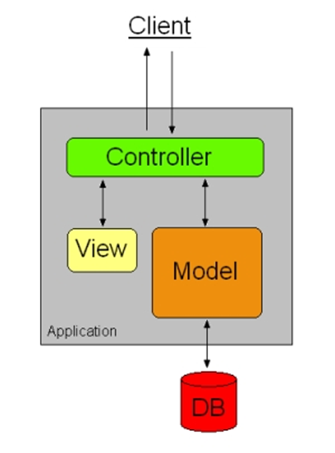
MVC Architecture
The controller delegates requests to an appropriate handler.
The controller is responsible for the input to the model.
A pure GUI controller accepts input from the user and instructs the model and viewport to perform action based on that input.
In the case of an invalid input, the model informs the controller to direct the view that error occurred and to tell it to try again.

Slide 39
MVC in a Web Application
A web application controller can be thought of as specialised view since it has a visual aspect
The controller can be one or more HTML controls/forms in a web application
The controller produces HTML to allow the user input a query to the web application
The controller adds the necessary parameterisation of the individual form element so that the model can observe the input
This is different from a desktop GUI, where the controller is waiting and acting on event-driven input from mouse or keyboard input

Slide 40
ASP.NET 4.5
Visual Studio 2012
Smaller ViewState
ASP.NET MVC 4
HTML5
Responsive design to easy allow development of mobile applications
Execute on all browsers installed on the machine
Editors (HTML, Java Script, CSS)
Authentication mode
Login (user name and ID)
From a different source

Slide 41
Videos
ASP.NET Web Forms 4.5:
https://www.youtube.com/watch?v=ntJLL5ysbgI
ASP.NET MVC 4: https://www.youtube.com/watch?list=PL37CBDB4EEDFC2AAC&v=ARsrnmhqwso
ASP.NET MVC 5: http://www.youtube.com/watch?v=gxFtRdKr7CA

